Slide 1
BookBot-Your personal AI companion for discovering great books
Built with IBM Watson Assistant Presented by: Kavisha Bhatia

Slide 2

What Problem Are We Solving?
Hard to get personalized, mood-based recommendations
Traditional search engines aren't conversational
Readers struggle to find books that match their current mood
"Let’s make discovering books feel like talking to a friend."

Slide 3
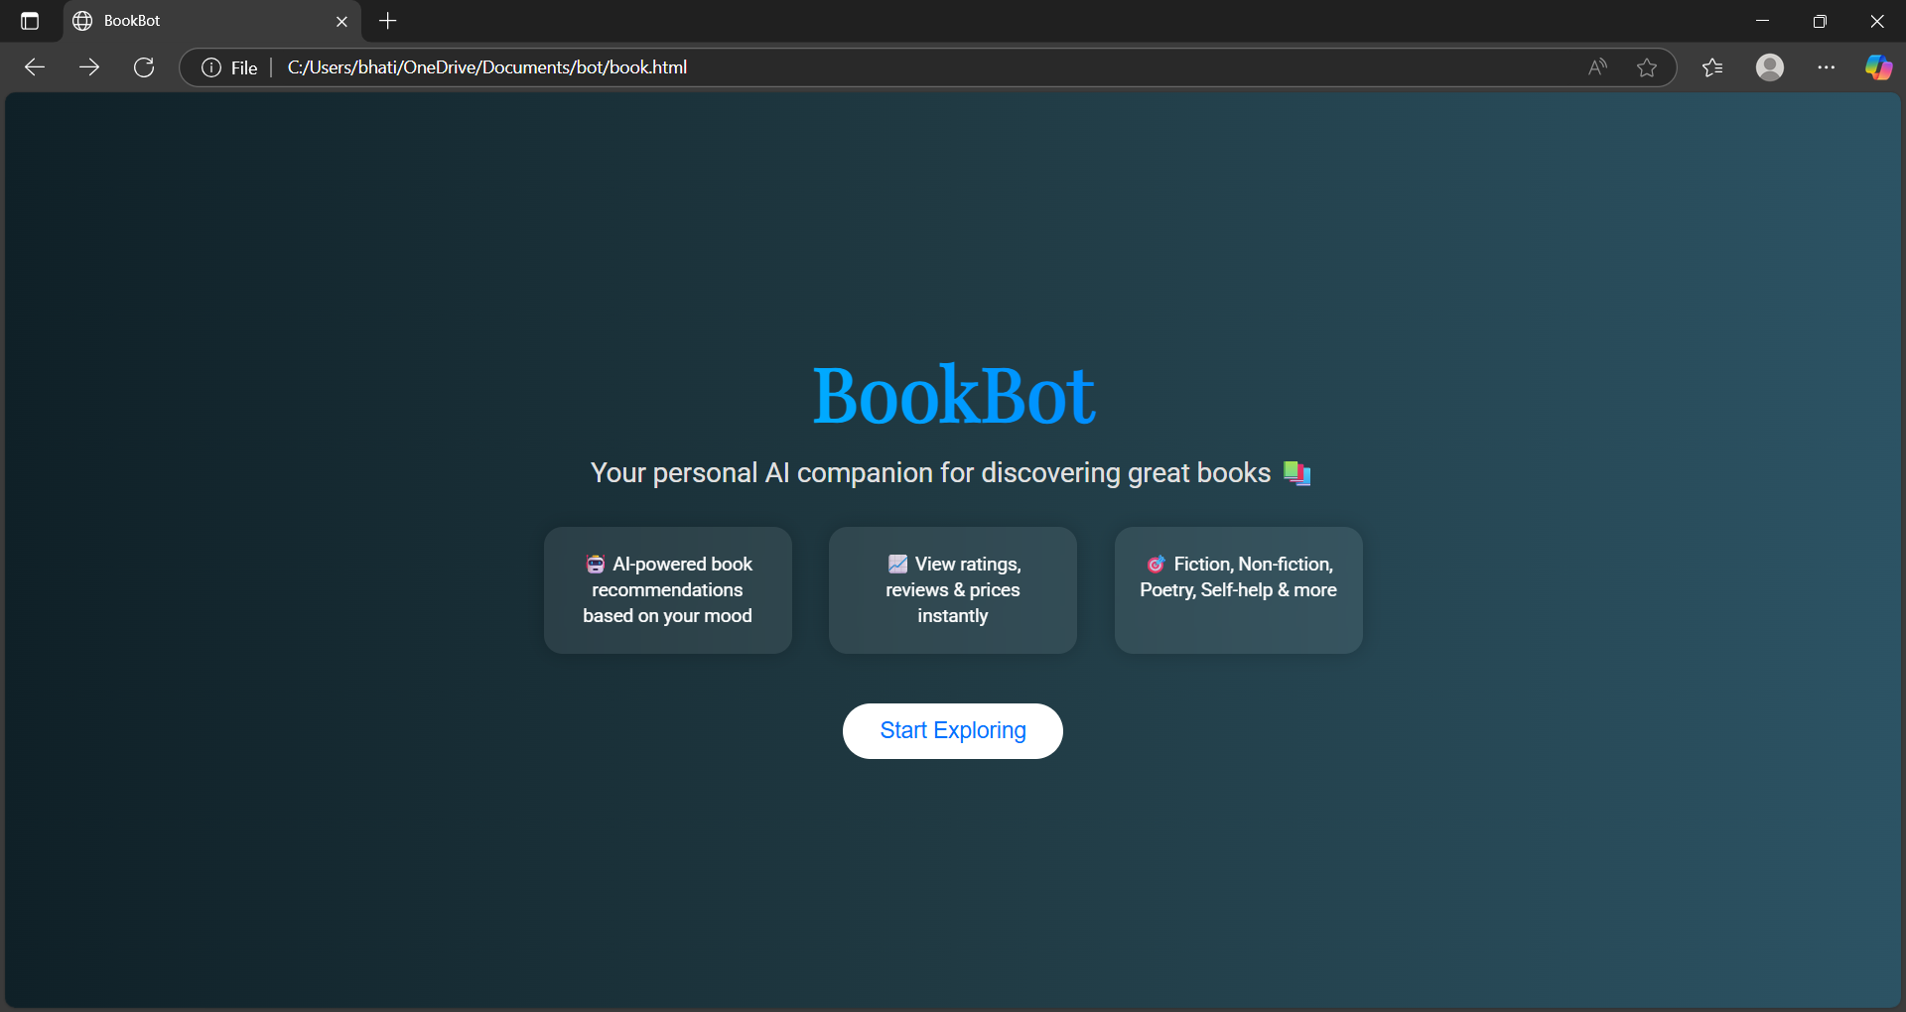
Introducing BookBot – Your AI Reading Buddy
Conversational AI chatbot using IBM Watson Assistant
Suggests books based on mood, genre, and interest
Feels like you’re chatting with a book-loving friend
Learns from user interaction over time to improve recommendations

Slide 4
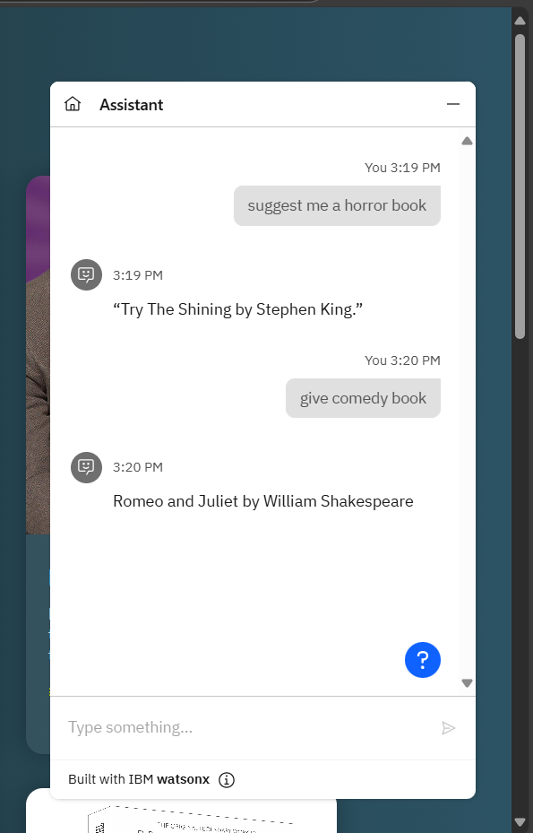
Features-
Mood-based book recommendations
Genre detection & entity classification
Fiction vs Non-fiction, poetry, drama support
Simple, engaging, chat-like experience
Can work without requiring user to input mood directly

Slide 5
Tools & Technologies Used
IBM Watson Assistant – Natural Language Understanding, Intents, Entities, Dialogs
HTML + CSS – Chat UI Design
GitHub – Version control and project hosting
Deployment – IBM Cloud / GitHub Pages
"The right book at the right time can change a life."

